Slide 1
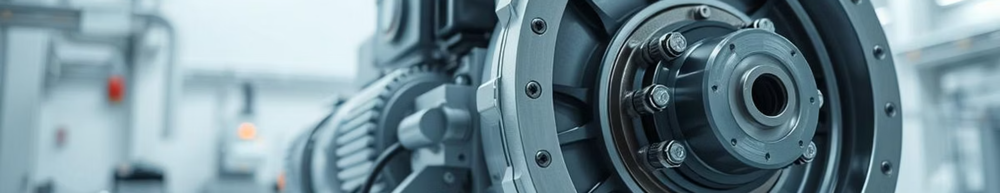
Predictive Maintenance of Gearboxes
Leveraging ML for Proactive Industrial Asset Management
By: Sahil Jadhav • Domain: Machine Learning • Tools: Python, Scikit-learn, XGBoost, NumPy, Pandas, Matplotlib, Seaborn

Slide 2



The Cost of Unexpected Downtime
Gearbox failures are a critical concern in industrial operations, leading to expensive downtime and complex repairs. Traditional maintenance strategies—whether reactive or preventive—often fall short, resulting in either unnecessary component replacements or unforeseen, catastrophic breakdowns.
High Costs
Inefficient Schedules
Catastrophic Failures
Unplanned repairs and lost production.
Either too early or too late for optimal action.
Risk of complete system breakdowns and safety issues.

Slide 3
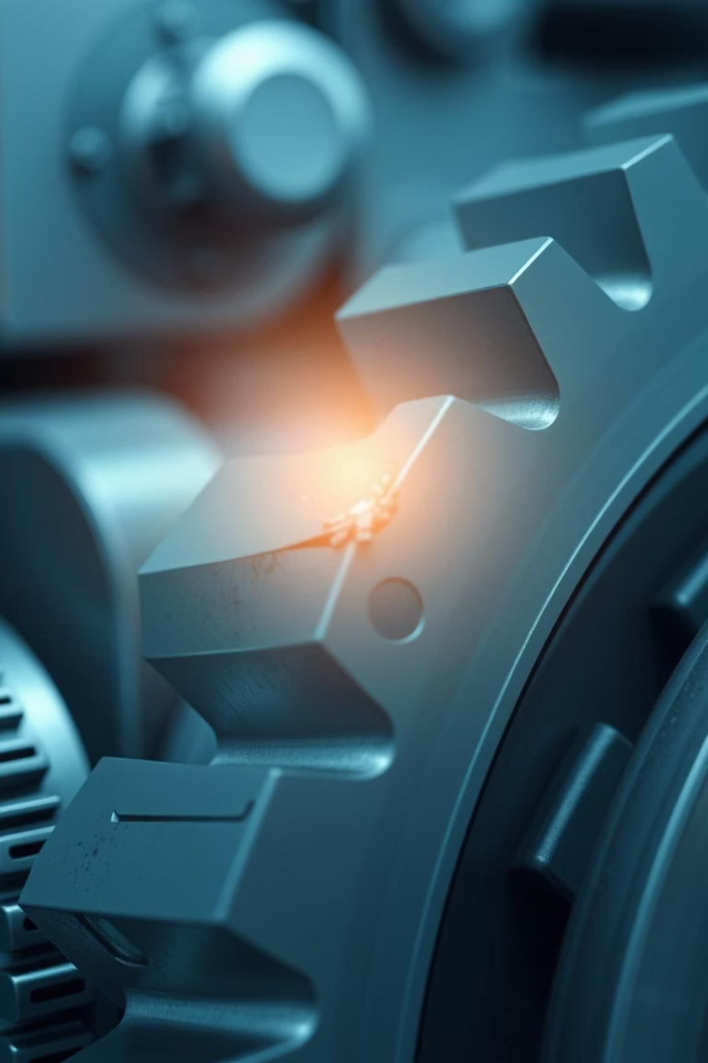
Predicting Failure: Our Core Objectives
Our primary goal is to shift from reactive to predictive maintenance. By leveraging machine learning on vibration data, we aim to detect incipient gearbox faults, specifically focusing on distinguishing between healthy and a broken tooth conditions, to enable proactive intervention.
Fault Detection: Build an ML system to identify gearbox issues (Healthy vs. Broken Tooth).
Cost & Downtime Reduction: Predict failures to minimize unnecessary expenses and operational interruptions.
Robustness: Ensure reliable model performance across varying load conditions (0–90%).
Real-Time Application: Develop a pipeline for seamless industrial integration.

Slide 4
Our Methodological Approach
We followed a comprehensive methodology to develop and validate our predictive maintenance system, focusing on robust data handling and model selection to ensure accuracy and reliability in real-world industrial settings.
1
Data Collection
Gearbox vibration data from 4 sensors, Healthy & Faulty conditions.
2
Preprocessing
Cleaning, normalization, and labeling (0=Healthy, 1=Faulty).
3
Feature Extraction
Time-domain (Mean, RMS, STD) & Frequency-domain (FFT, Spectral Centroid).
4
Model Training & Eval
XGBoost (best performer), assessed with Accuracy, F1-score, Confusion Matrix.
5
Integration
Real-time prediction pipeline using joblib for model loading.

Slide 5
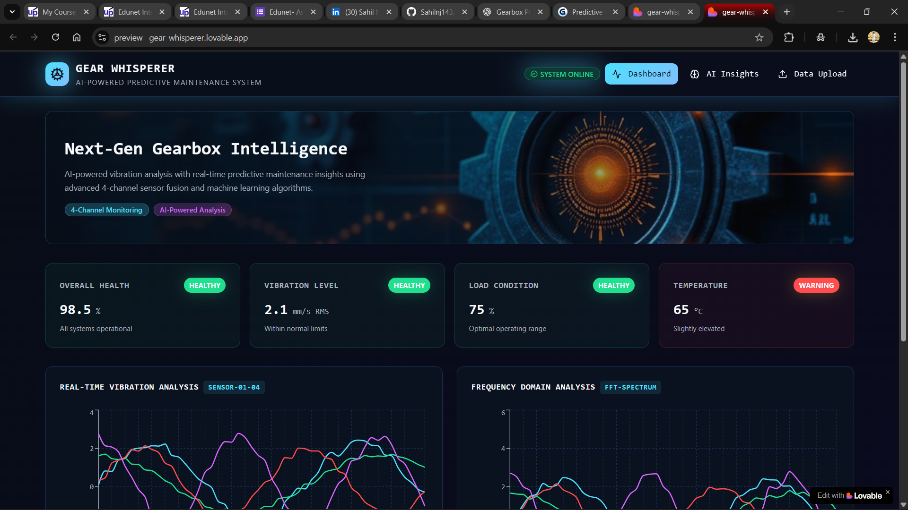

Slide 6
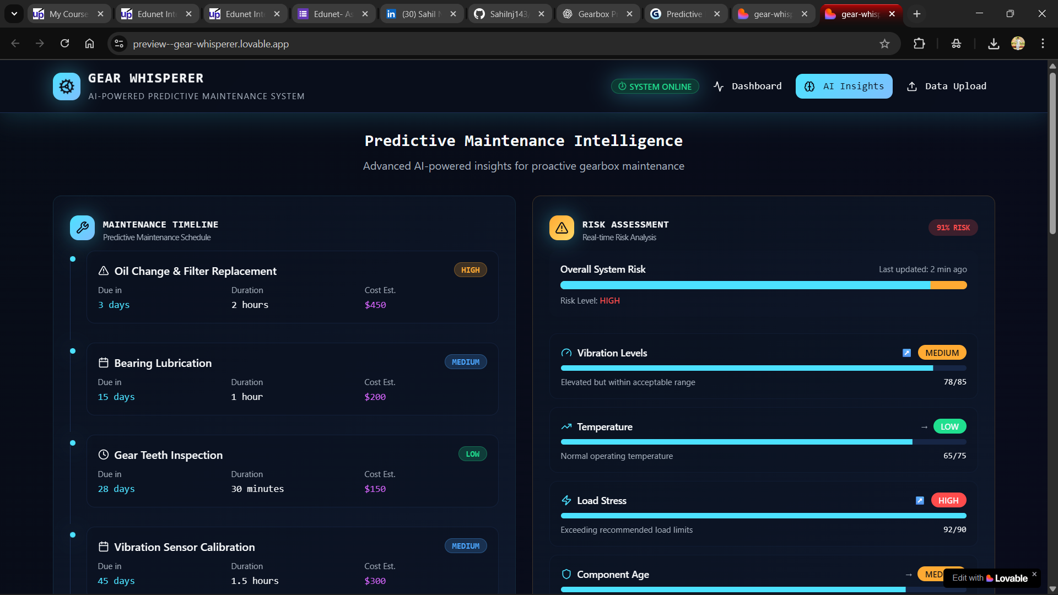

Slide 7
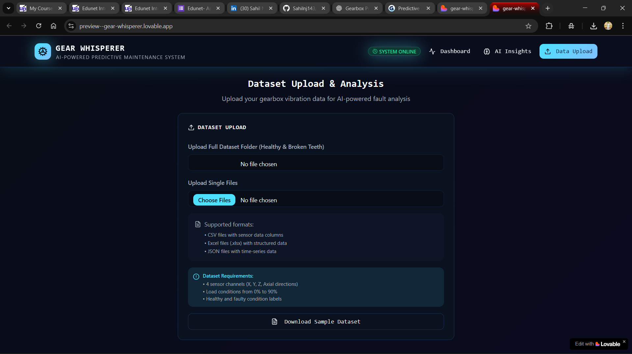

Slide 8
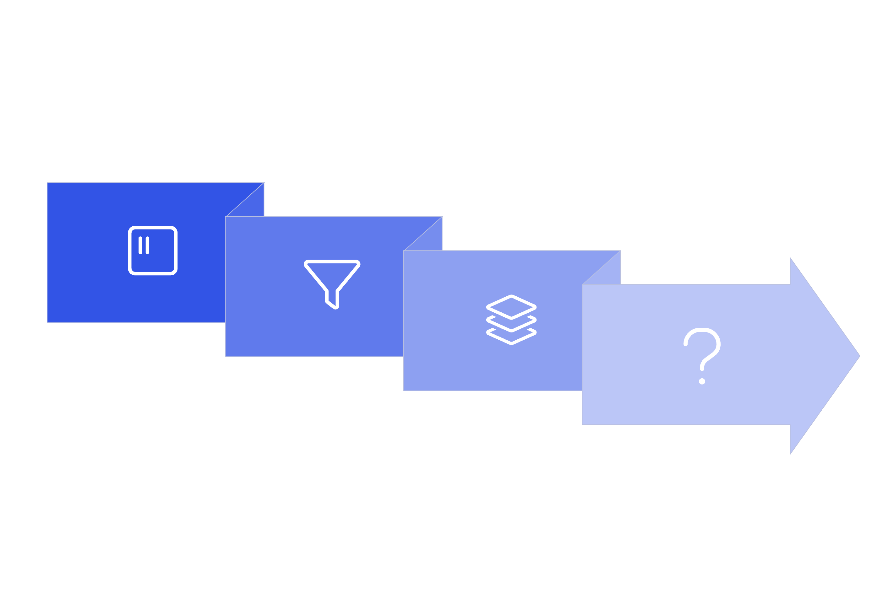




System Workflow Design
Our system is designed for a streamlined, real-time predictive maintenance workflow, transforming raw vibration data into actionable fault predictions that seamlessly integrate into industrial operations.
Preprocessing
Prediction
Data Acquisition
Feature Extraction
Input: Raw vibration data from industrial sensors.
Preprocessing: Data cleaning and normalization for consistent input.
Feature Extraction: Derivation of key time and frequency domain features.
ML Model: XGBoost classifier for robust fault detection.
Output: Clear 'Healthy' or 'Faulty' prediction with a confidence score.

Slide 9

Conclusion & Future Outlook
We successfully developed and validated a robust predictive maintenance system for gearbox fault detection, achieving high accuracy and real-time capability under varying load conditions.
Key Achievements
Future Scope
Achieved ~97% accuracy in fault detection.
Integrate with IoT sensors for live data streams.
Validated robustness across varied load conditions (0-90%).
Expand detection to multiple fault types (e.g., bearing wear).
Real-time simulation confirmed industrial readiness.
Deploy as a cloud-based monitoring dashboard.

